Slide 1
Why Containers?

Slide 2
What are containers
A container is a standard unit of software that packages up code and all its dependencies so the application runs quickly and reliably from one computing environment to another.
It includes everything needed to run the application: code, runtime, system tools and libraries as well as settings.
Multiple containers are run by a single OS kernel, therefore are more lightweight than virtual machines.
Notes:
Containers offer a logical packaging mechanism in which applications can be abstracted from the environment in which they actually run.
This decoupling allows container-based applications to be deployed easily and consistently, regardless of the target environment
Containerization provides a clean separation of concerns – isolation.
Developers focus on their application logic and dependencies; IT Ops focus on deployment and management.

Slide 3

Why Containers
Works on my machine
Every environment looks the same
Increased velocity
Run anywhere
Notes:
Containers give developers the ability to create predictable environments, isolated from other applications.
Every dependency needed by the application, versions of the runtime, libraries etc., are included in the container and guaranteed to be consistent regardless of where the image is deployed
This equals productivity. Developers and Ops teams spend less cycles debugging or diagnosing environment issues and more time pushing features and enhancements to the users.

Slide 4
Containers run everywhere
Linux
Windows
Cloud
Drones, Raspberry PI, IoT
Notes:
Containers run anywhere, easing the development and deployment of applications. Windows, Mac, Linux, datacenters, cloud and even IoT.
The widespread popularity of the Docker image format for containers helps with the portability. Wherever you want to run your software, you can likely use containers.

Slide 5
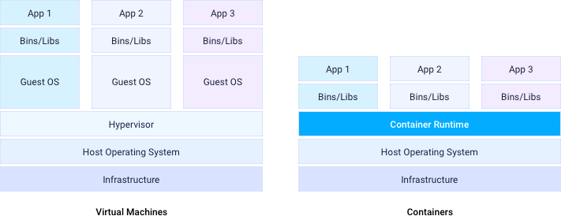
Docker Containers
Containers vs Virtual Machines
Virtual Machines
Shared host OS kernel
Portability
Faster scalability
Separate OS per instance
Large footprint
Slower startup
Notes:
Within each virtual machine runs a unique guest operating system.
VMs with different operating systems can run on the same physical server—a UNIX VM can sit alongside a Linux VM, and so on.
Each VM has its own binaries, libraries, and applications that it services, and the VM may be many gigabytes in size.
Containers sit on top of a physical server and its host OS—for example, Linux or Windows.
Each container shares the host OS kernel and, usually, the binaries and libraries, too.
Shared components are read-only. Containers are thus exceptionally “light”—they are only megabytes in size and take just seconds to start,
versus gigabytes and minutes for a VM.
Virtual machines and containers differ in several ways, but the primary difference is that containers provide a way to virtualize an OS so that multiple workloads can run on a single OS instance.
With VMs, the hardware is being virtualized to run multiple OS instances.

Slide 6
Dockerfile Example
Dockerfile
FROM mcr.microsoft.com/dotnet/core/sdk:3.0
ENV ASPNETCORE_ENVIRONMENT=Development
WORKDIR /app
COPY . .
RUN dotnet restore
ENTRYPOINT[“dotnet”,”run”]
Run: docker build –t tailwindtraders .
to build the docker image
Notes:
Here is basic example of a Dockerfile, it uses the base image for .NET Core 3.0 which in this case is based on Debian
Setting an ENVIRONMENT variable
Setting a working directory of “app”
Copying the source files there
Restoring the package dependencies and then running the command “dotnet run”
This Dockerfile is a template for the application to be built into an image run anywhere containers are supported.

Slide 7
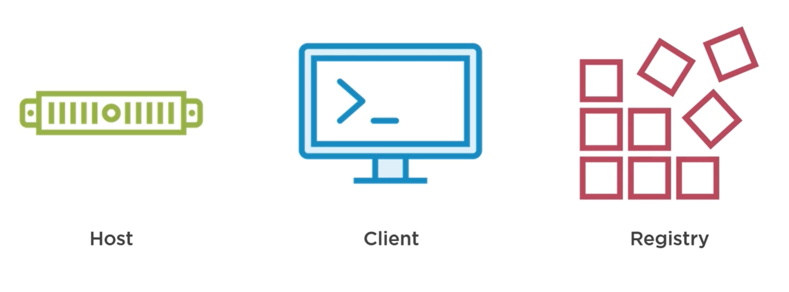
Docker Architecture
Notes:
Host – manage docker objects like images, containers, networking. Provides http Api for managing containers
Client – CLI
docker build
docker pull
docker run

Slide 8
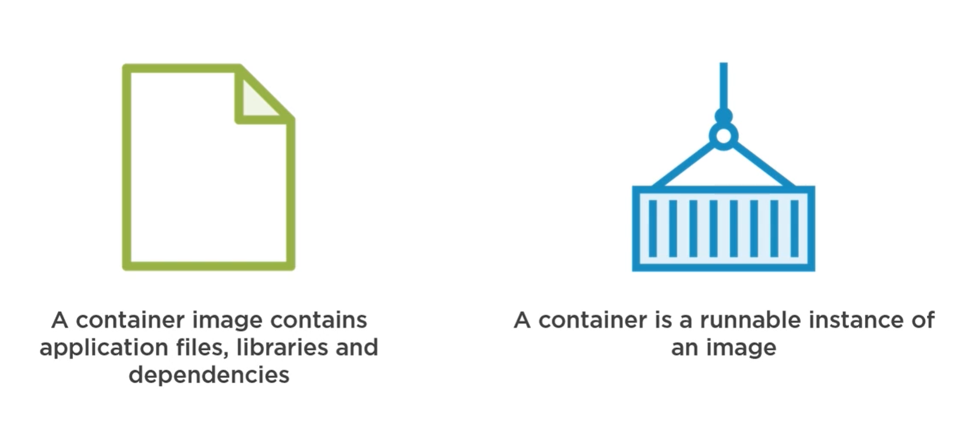
Containers and images
Notes:
Outputem z naszej aplikacji przestaja byc pliki uruchamialne – nie sa te exeki mimo ze mamy .net core program
Teraz mamy obrazy.
Kontener to miejsce uruchomienia obrazu
Obraz – klasa
Kontener – instancja obiekt

Slide 9
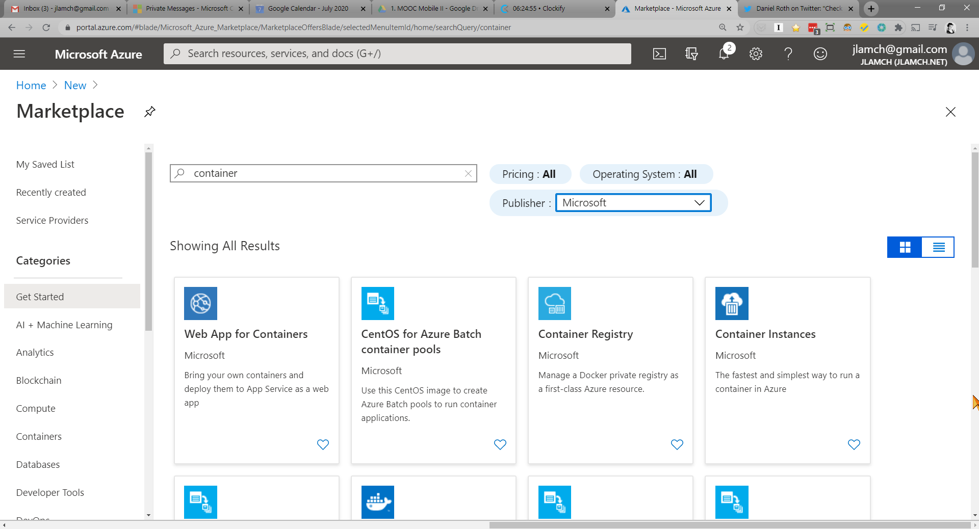

Slide 10
Azure Container Instances (ACI)
Notes:
shell.azure.com

Slide 11
What is Azure Container Instances (ACI)?
Run Containers with a single command
Per-second Billing
No virtual machine management
Notes:
You can start a container using a single command. This command can be run on the command line, Azure DevOps, LogicApps; many options.
Per second billing, Only be charged for the time the container is running.
Just run the container, there is no infrastructure to manage.

Slide 12
Create an instance using the Azure CLI
Azure CLI
$ az group create --name myResourceGroup --location eastus
$ az container create -n mycontainer --image microsoft/aci-helloworld -g myResourceGroup --ip-address public
Create a resource group
az container create : creates instance of container
Notes:
-n is the shorthand for --name, as is –g for --resource-group
Creating an instance is easy in single command. Well in this case, 2 commands because we must create a resource group ( a logical grouping of assets or objects)
The ip-address option is set to public so the instance is available externally.

Slide 13
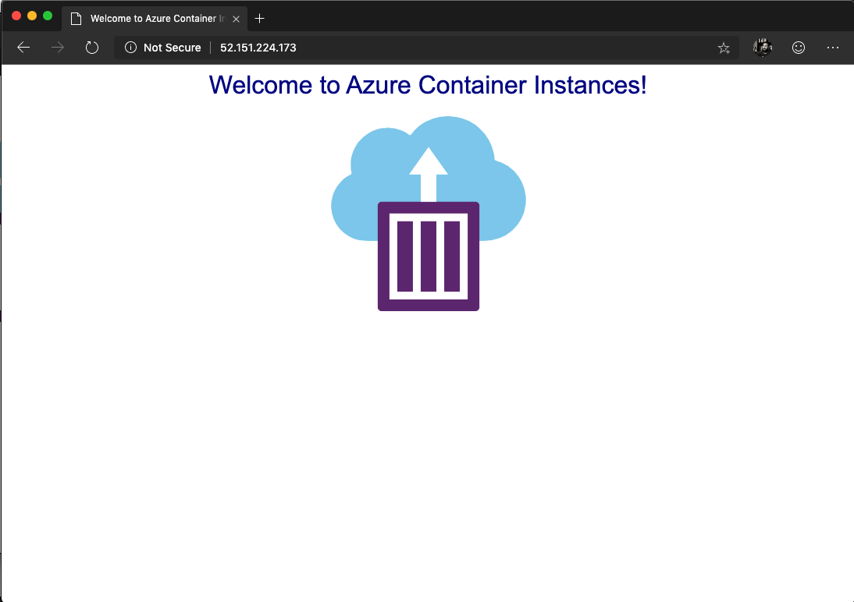
Running Container Image
az container create
"ipAddress": {
"ip": "52.151.224.173",
"ports": [
{
"port": 80,
"protocol": "TCP"
}
]
},
"location": "eastus",
"name": "mycontainer",
"osType": "Linux",
"provisioningState": "Succeeded",
Notes:
Once the container Is created, the output (snippet here) contains a lot of information but the important piece is the IP which we can either use curl to get the results or
Open browser to view the results.

Slide 14
What are the use cases for ACI?

Slide 15
What can you build with Azure Container Instances?
Data processing jobs
Event-driven applications with Azure Logic Apps
Virtual nodes, elasticity for Kubernetes on AKS
Notes:
Have you ever had that server or machine that just existed to run those console apps on the windows scheduler? Every Monday at 10 am it would run myjob.exe – Now put that app in a container, and run it in the cloud and oly be charged when it runs.
Data processing apps, Reporting, CI Jobs, are all good options. Using ACI in place of VM reduces footprint as well as costs.
ACI also provides fast, isolated compute to handle spikes without managing servers. Through the use of Virtual Kubelet, your AKS cluster is enabled to scale and provision pods in seconds with just enough capacity to handle the load.

Slide 16
Advanced Features of Azure Container Instances
Container groups
Manage state with Azure file shares
Deploy from Azure Container Registry portal
Notes:
Azure Container Instances supports the deployment of multiple containers onto a single host using a container group
A container group is useful when building an application sidecar for logging, monitoring, or any other configuration where a service needs a second attached process.
By default, Azure Container Instances are stateless. If the container crashes or stops, all of its state is lost. To persist state beyond the lifetime of the container, you must mount a volume from an external store.

Slide 17

Limitations of Azure Container Instances
Zero-downtime upgrades
Batch workflows
Service discovery
Integrated load balancing
Auto-scaling
Notes:
If you need these features, you probably need an orchestrator – see Kubernetes via AKS

Slide 18
Azure Container Registry (ACR)

Slide 19
What is a container registry?
A repository for storing container images
Public registries i.e. Docker Hub – free & easy
Private registries allow for efficient/secure storage
Notes:
How does it help in building, shipping and running an application? Why might an organization need a private registry to securely and efficiently manage their container images? All good questions. A good analogy is GitHub or code repositories.
The container is a snapshot of your application and its dependencies. Once the image is created, the registry is a place to hold this application template. A registry is a way to share the application between systems. Docker Hub is a public registry available and easy to use via the internet. However, as with our code, their may be restrictions the prohibit us from storing these images outside of our domain, country, etc. For instance, Intellectual Property (IP) or sensitive data restrictions are most common.
A private registry allows for your organization to setup RBAC (Role based Access Control) to the registry based on LDAP or AD already setup within your organization to enforce rules such as push, pull access.

Slide 20
Azure Container Registry (ACR)
Manage a Docker private registry as a first-class Azure resource

Slide 21
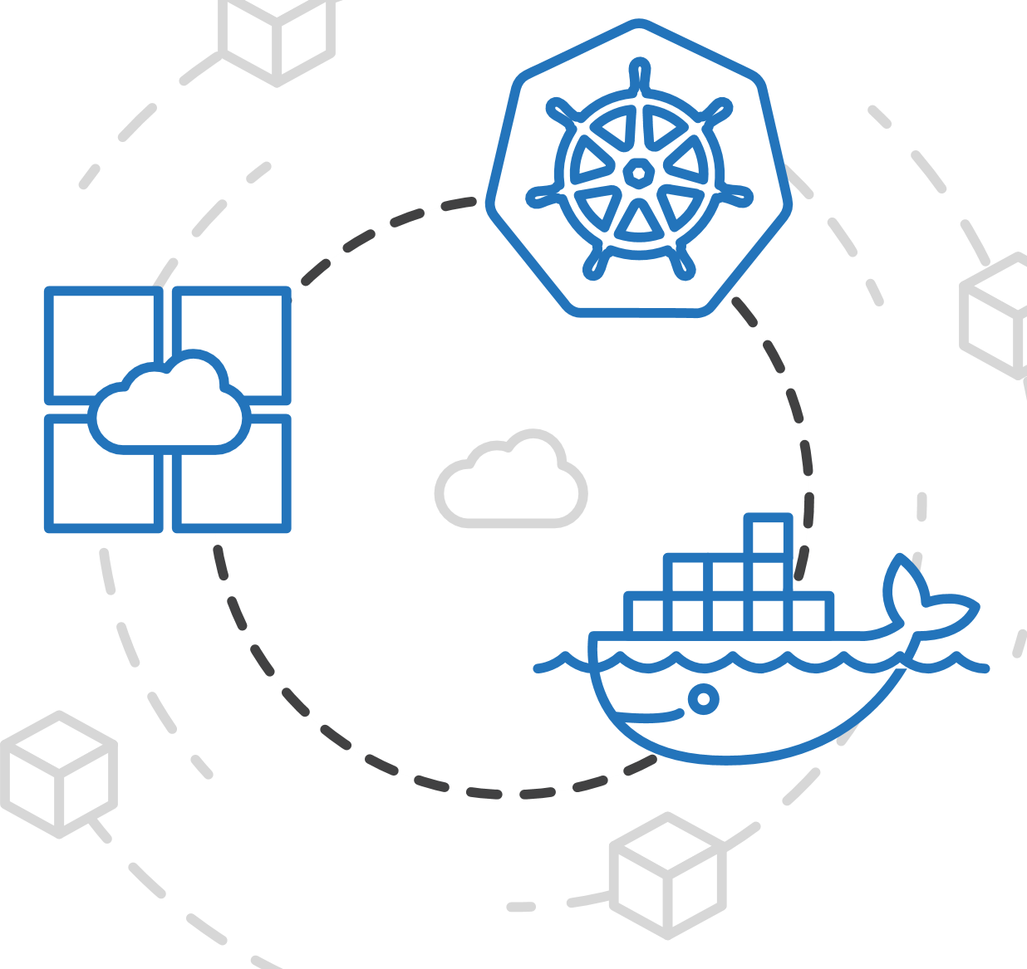
Azure Container Registry (ACR)
Manage a Docker private registry as a first-class Azure resource
Manage images for all types of containers
Notes:
ACR allows you to store images for all types of container deployments. Mesosphere, Docker Swarm, Kubernetes, and Azure services. You or your DevOps team can seamlessly integrate the build and deploy process with ACR.

Slide 22
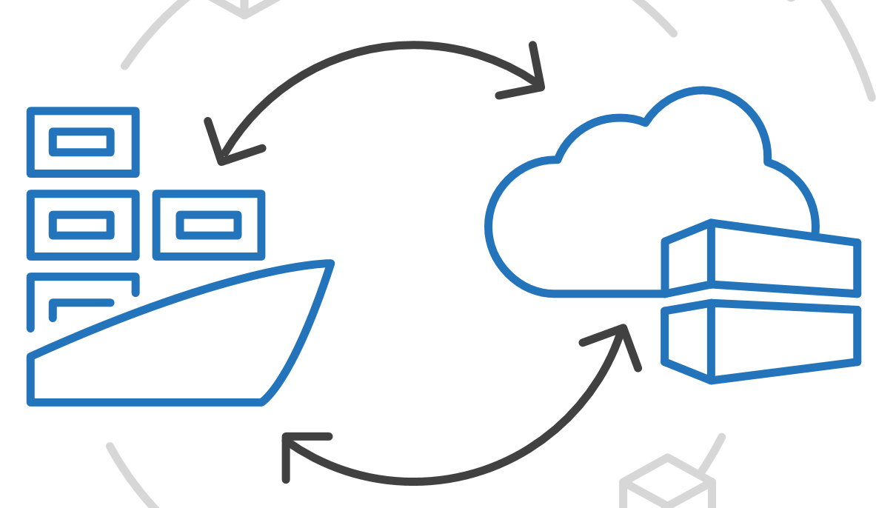
Azure Container Registry (ACR)
Manage a Docker private registry as a first-class Azure resource
Manage images for all types of containers
Use familiar, open-source Docker CLI tools
Notes:
Docker’s command line interface works directly with ACR using the login, push, pull commands just as you would with Docker Hub.
No new APIs or commands to learn.

Slide 23
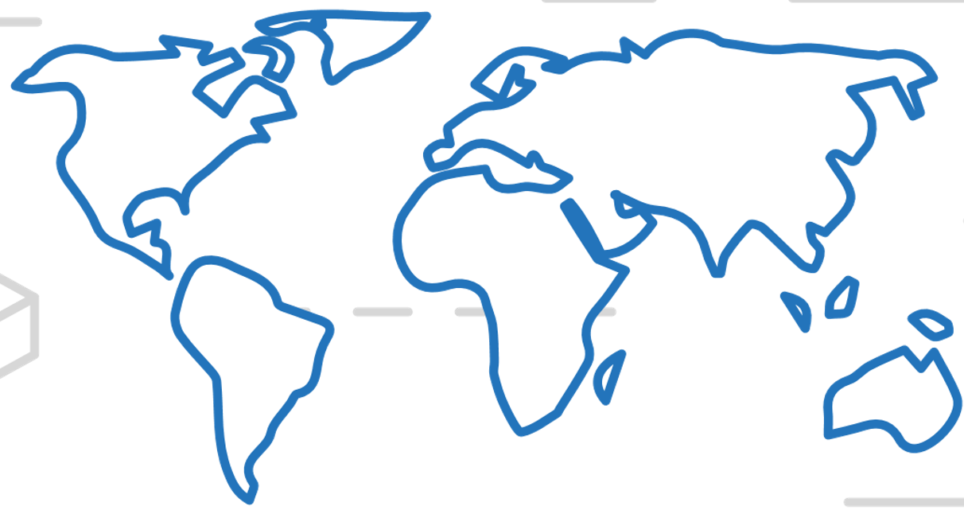
Azure Container Registry (ACR)
Manage a Docker private registry as a first-class Azure resource
Manage images for all types of containers
Use familiar, open-source Docker CLI tools
Azure Container Registry geo-replication
Notes:
Efficiently manage a single registry replicated across multiple regions. Geo-replication enables you to manage global deployments as one entity to simplify operations and management.
Reduce the network latency and eliminate any ingress/egress charges by keeping your registry in the same data center as your deployments. ACR gives you local, network-close storage of your container images and full control
over naming and organization of the images.

Slide 24
Azure Container Registry (ACR)
Create a container registry in the portal quickly

Slide 25
Azure Container Registry
Azure CLI : Create ACR
$ az acr create --resource-group myResourceGroup --name myContainerRegistry
--sku Basic
Using the Azure Command Line tool
Single command to create a private registry
Notes:
This is a simple BASIC registry, a cost optimized option. Good for getting started, more options in SKUs for global replication etc for Production.

Slide 26
Commands
ACR Commands
$ az acr login –n myacr
$ docker pull myacr.azurecr.io/hello-world
$ docker push myacr.azurecr.io/hello-world
$ docker rmi myacr.azurecr.io/hello-world
Logging into the registry
Standard Docker commands
Push, Pull, Removing images

Slide 27

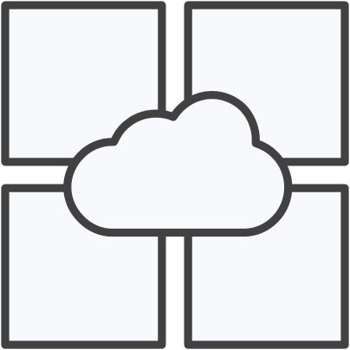

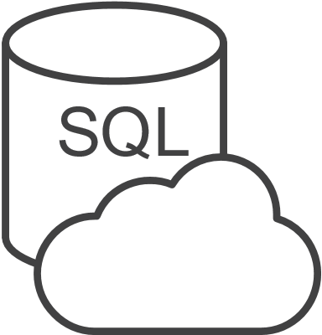

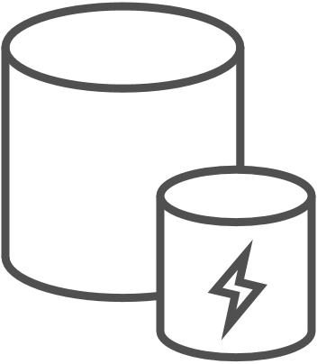
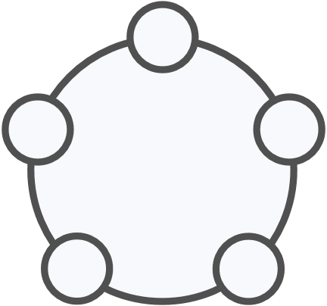
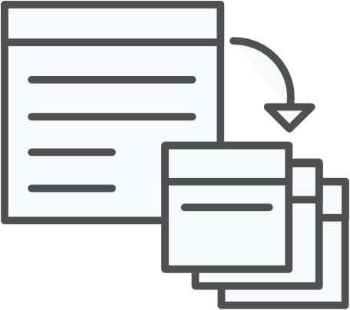


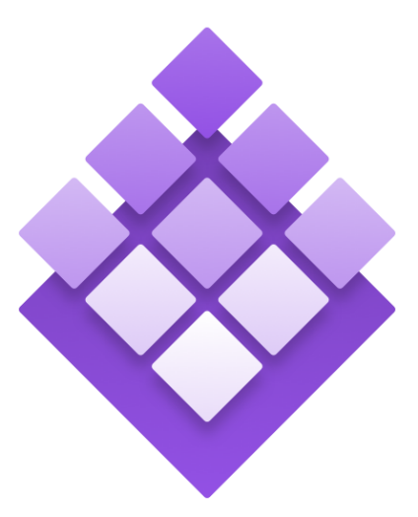
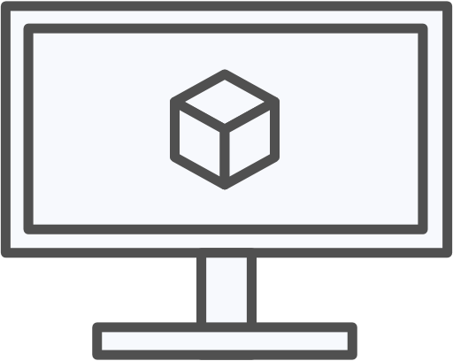
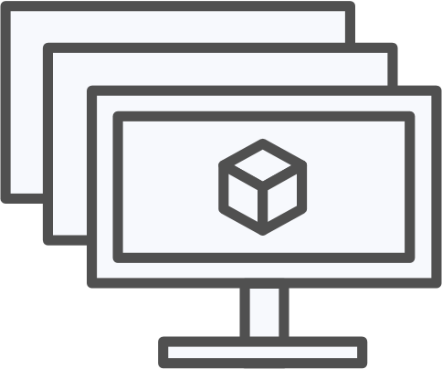
Azure Container Registry
OSBA
App Service
Azure Container Registry (ACR)
Partner services
Azure services
PaaS
OpenShift
SQL Database
Azure Container Service (AKS)
Service Fabric
Batch
Pivotal Cloud Foundry
Redis Cache
ACS Engine
Docker Enterprise Edition
CosmosDB
Virtual Kubelet
Mesosphere DC/OS
And more!
Azure Container Instances (ACI)
Azure Virtual Machines
Virtual Machine Scale Sets (VMSS)
Azure
IaaS
Notes:
The Azure Container Registry is positioned close to all of your other Azure objects, VMs, Kubernetes clusters in AKS, AppService, ACI as discussed previously. Therefore when pulling the image for your applications to these resources, the latency is greatly reduced.
This is benefit for scaling, CI/CD for builds and deployments and so forth.
Using public repositories such as Docker Hub or even GitHub; the ingress/egress costs are incurred leaving Azure plus the network latency going outside of this infrastructure.

Slide 28
Azure App Service

Slide 29
Azure App Service
Multiple languages and frameworks
Scalability and high availability
DevOps optimization, security, and compliance
Templates, IDE integration, serverless and much more…
Notes:
Azure App Service is an HTTP-based service for hosting web applications, REST APIs, and mobile back ends. You can develop in your favorite language, be it .NET, .NET Core, Java, Ruby, Node.js, PHP, or Python. Applications run and scale with ease on both Windows and Linux-based environments.
Deploy Apps from GitHub, Azure DevOps, even DropBox! App Service offers just about every piece you’d need to run a scalable, secure web application.
Speak to slot deployments, scalability points, and that is is the basis for serverless apps too.

Slide 30

Azure App Service
Fully managed compute platform
Optimized for hosting websites and web apps
Windows and Linux natively or Containers
Options for very high scale, isolated environments
Notes:
App Service is a fully managed compute platform that is optimized for hosting websites and web applications.
Customers can use App Service on Linux to host web apps natively on Linux for supported application stacks.
Node, Java, PHP, Python, .NET Core, Ruby can all be run natively or within containers.

Slide 31
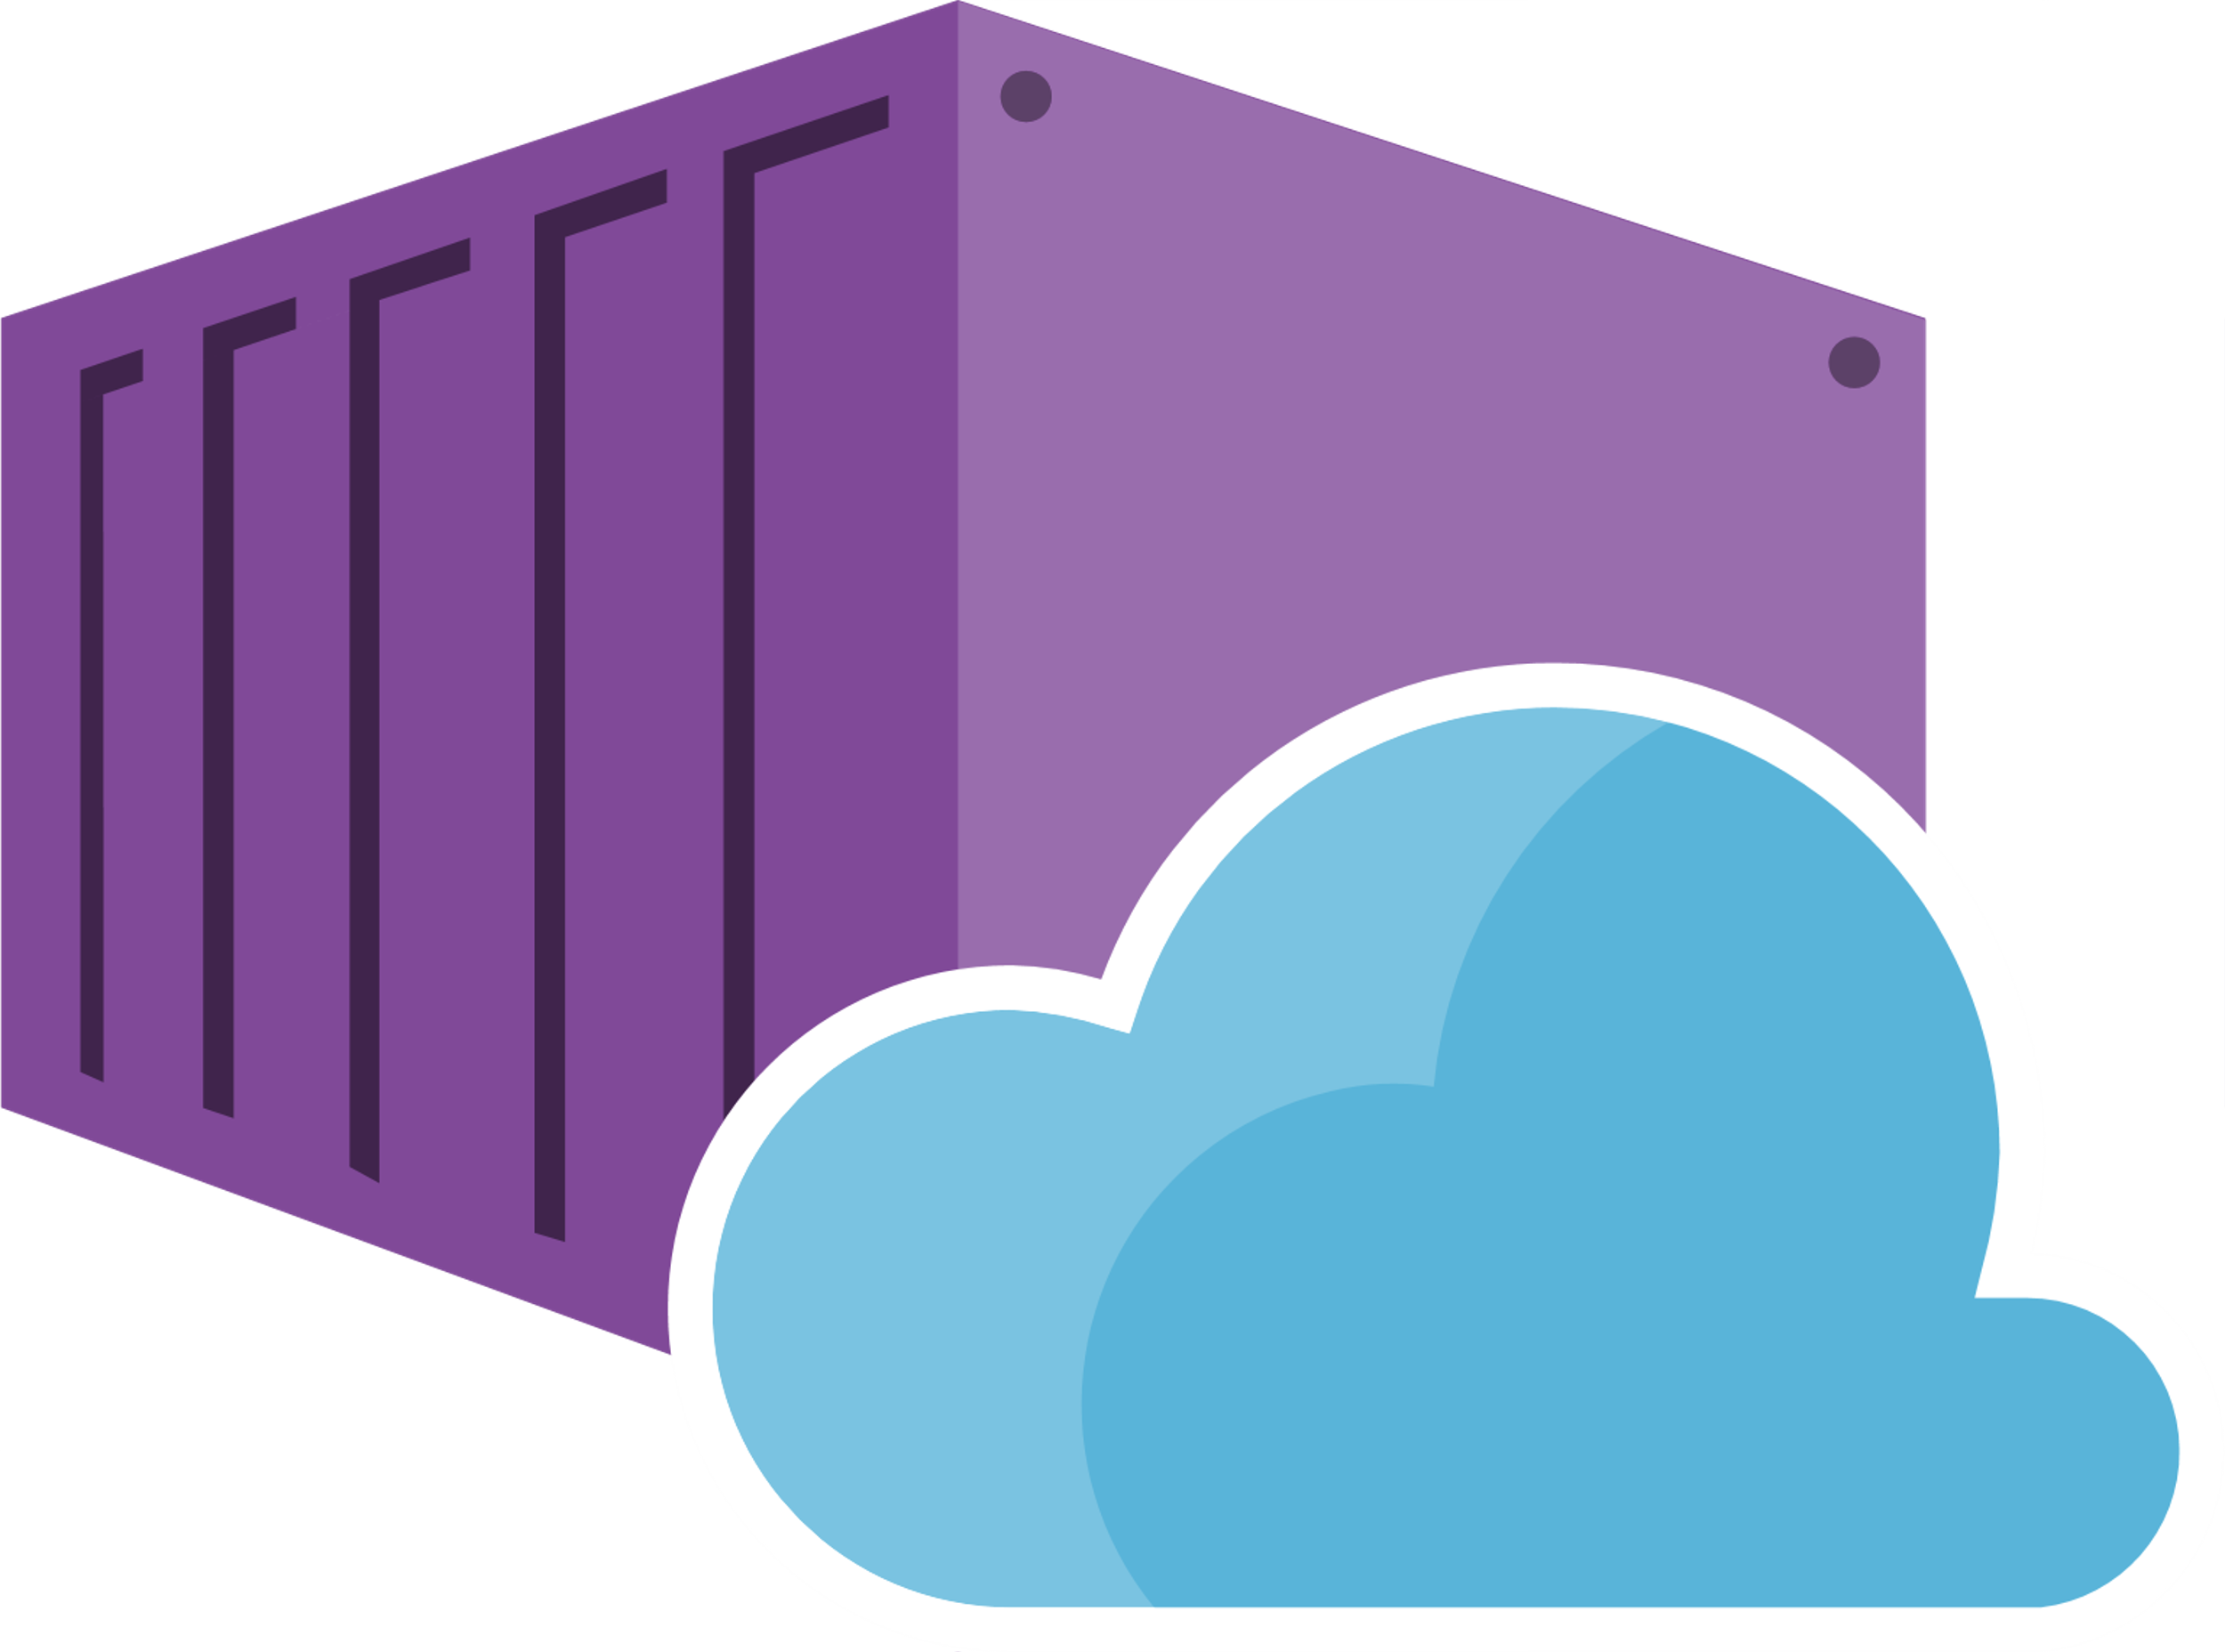
Web App for Containers
Easily deploy and run and containerized apps
Take advantage of built-in auto scaling and load balancing
Streamline CI/CD with Docker Hub, Azure Container Registry, and GitHub
Notes:
Just pull container images from Docker Hub or a private Azure Container Registry, and Web App for Containers will deploy the containerized app with your preferred dependencies to production in seconds.
Simplify your container image deployments through CI/CD) capabilities with Docker Hub, Azure Container Registry, and DevOps. App Service creates an association with the selected repository, so your apps are updated each time your source code changes.
Scaling based on load; CPU, RAM etc. Load balancing is handled, Can be overridden manually with CLI or in the portal.

Slide 32
Azure Kubernetes Service (AKS)

Slide 33
Orchestration
Scheduling
Affinity/anti-affinity
Health check monitoring
High availability
Scalability
Networking
Service discovery
Coordinated update
Notes:
Affinity – odleglosc miedzy kontenerami – rozucone albo nie
Health – restarty, nowy pod gdy potrzeba
High availability – przelaczanie awaryjne, dostawianie podow
Networking – duzy wiekszy niz w iaas

Slide 34
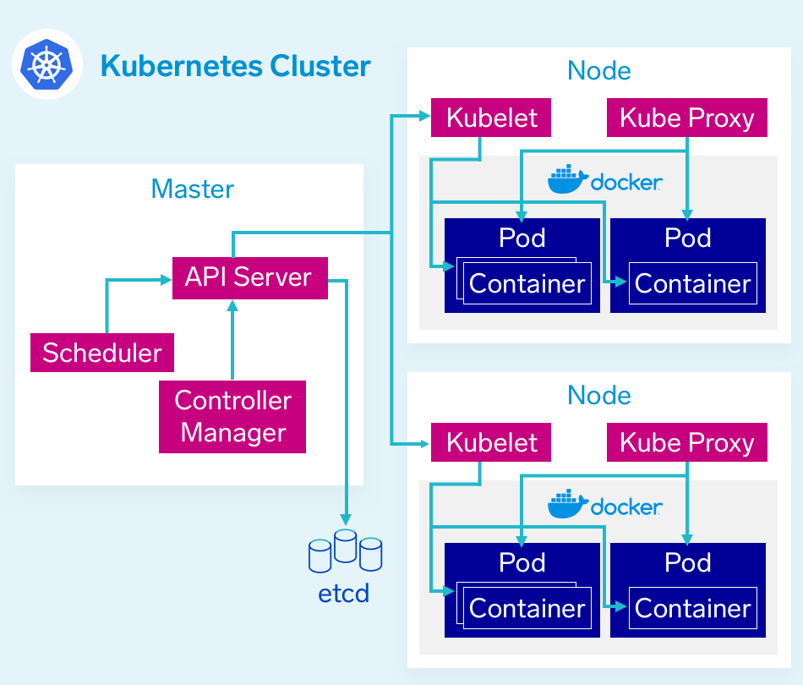
Kubernetes architecture
The Control Plane – The Master
Nodes – Where pods get scheduled
Pods – Holds containers
Notes:
Etcd – przechowuje obrazy – key-value. Api server trzyma tam swoj stan.
Api server – rest api komunikacja miedzy wszystkimi komponentami I swiatem zewnetrznym (np cicd)
Scheduler – przypisanie instancji aplikacji do wezlow
Control Manager – operacje na calym klastrze + integracje z komponentami zewnetrzymi jak chmury
Worker node – Node
Kublet – orchestrator na poziomie noda
Kub proxy – komunikacja
Container runtime – moze byc Docker ale moga byc inne. Srodowisko uruchomieniowe.
POD – podstawowy logiczny element – posiada swoje ip oraz zasoby w klastrze. Pozwala uruchomic kontener lub wiele (side car – pomocnicze kontenery dla naszej aplikacji)

Slide 35
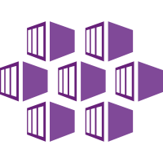
Azure Kubernetes Service (AKS)
Fully managed Kubernetes service
Elastic provisioning
Fast end-to-end development
Identity and access management with AD
Orchestration across 29 regions, Azure stack, IoT
Notes:
The fully managed Azure Kubernetes Service (AKS) makes deploying and managing containerized applications easy. It offers serverless Kubernetes, an integrated continuous integration and
continuous delivery (CI/CD) experience, and enterprise-grade security and governance.
single platform to rapidly build, deliver, and scale applications with confidence.

Slide 36
Azure Kubernetes Service (AKS)
The elements of orchestration
Scheduling
Affinity/anti-affinity
Health monitoring
Failover
Scaling
Networking
Service discovery
Coordinated app upgrades

Slide 37
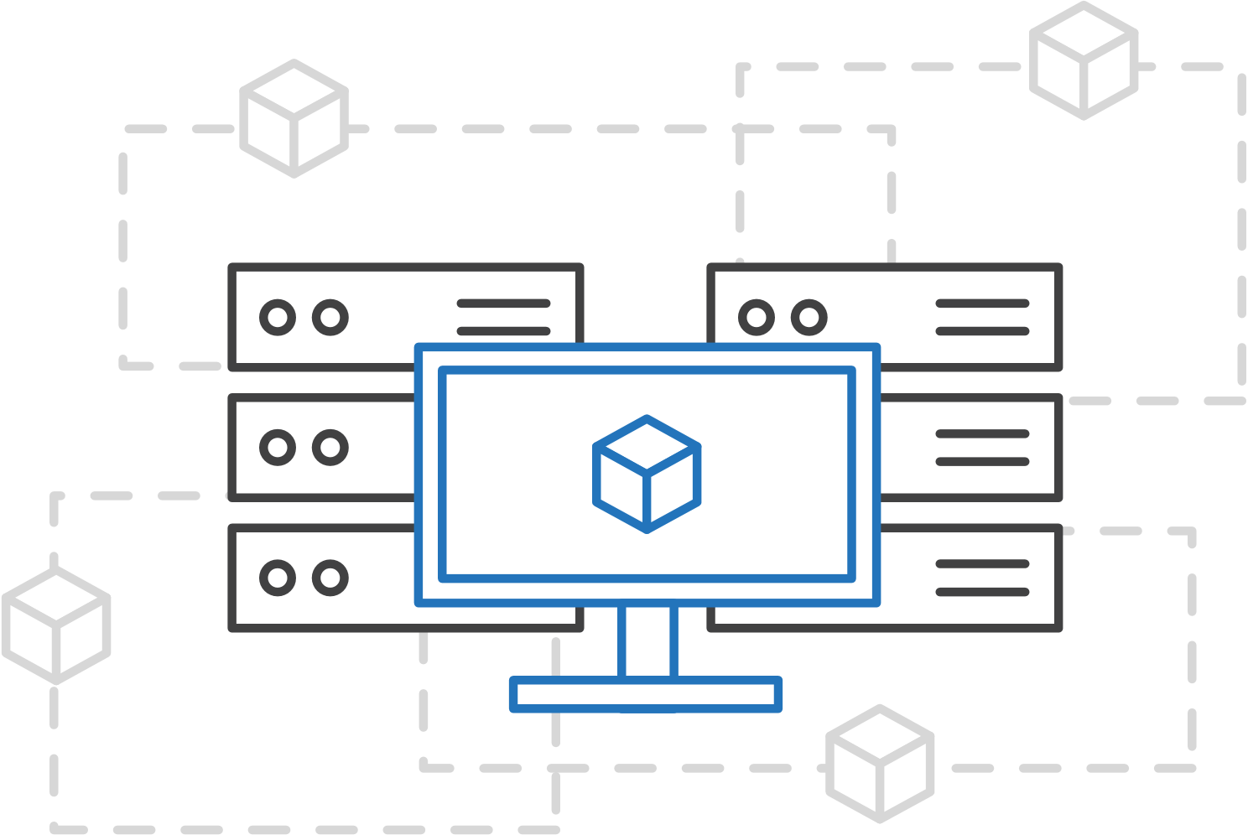
Azure Kubernetes Service (AKS)
Simplify Kubernetes deployment, management, and operations
Focus on your containers, not infrastructure
Notes:
Easily provision clusters using the CLI or infrastructure-as-code tools such as Terraform. Minimize infrastructure maintenance using automated upgrades, repair, monitoring, and scaling.
Elastically provision additional compute capacity in serverless Kubernetes in seconds without worrying about managing the infrastructure.

Slide 38
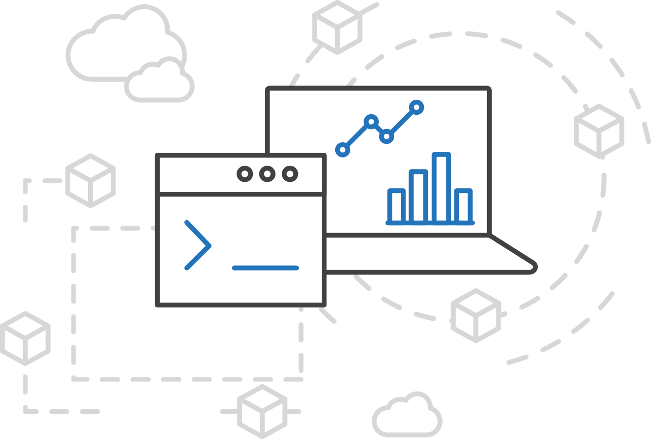
Azure Kubernetes Service (AKS)
Simplify Kubernetes deployment, management, and operations
Focus on your containers, not infrastructure
Work how you want with open-source APIs
Notes:
Easily provision clusters using the CLI or infrastructure-as-code tools such as Terraform. Minimize infrastructure maintenance using automated upgrades, repair, monitoring, and scaling.
Elastically provision additional compute capacity in serverless Kubernetes in seconds without worrying about managing the infrastructure.

Slide 39
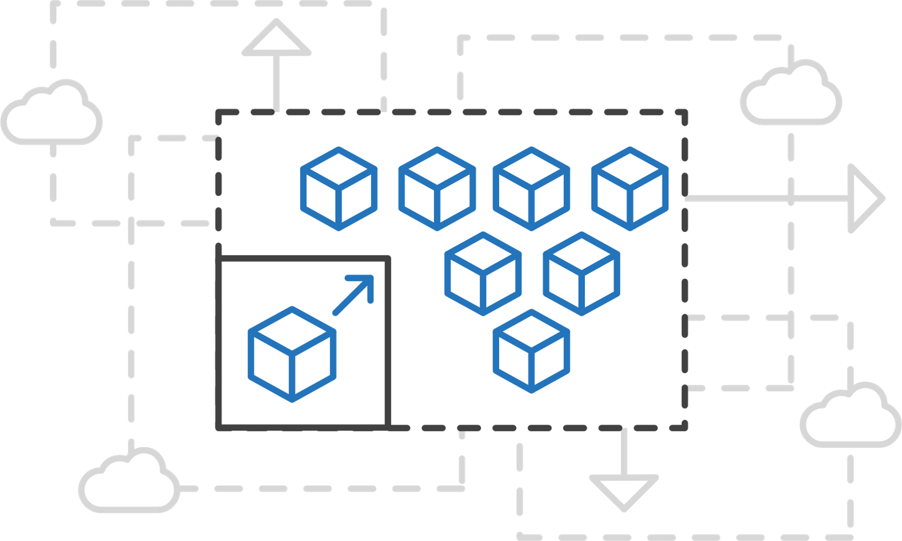
Azure Kubernetes Service (AKS)
Simplify Kubernetes deployment, management, and operations
Focus on your containers, not infrastructure
Work how you want with open-source APIs
Scale and run applications with confidence
Notes:
Easily provision clusters using the CLI or infrastructure-as-code tools such as Terraform. Minimize infrastructure maintenance using automated upgrades, repair, monitoring, and scaling.
Elastically provision additional compute capacity in serverless Kubernetes in seconds without worrying about managing the infrastructure.

Slide 40
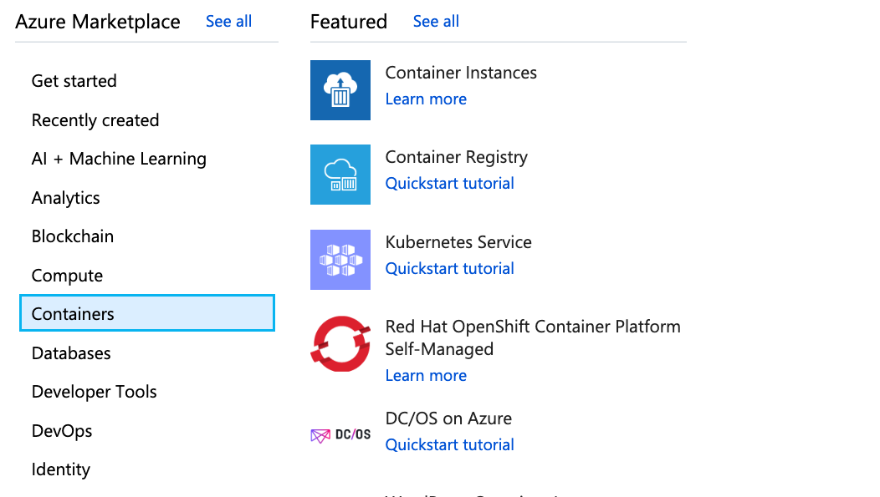
Azure Container Service (AKS)
Create an AKS cluster via the Azure portal
All functions available via the portal and Azure CLI
Notes:
- Select create new from the left side > Containers > Kubernetes Service
- Alternatively you may use the search box as well and use Kubernetes, Con

Slide 41
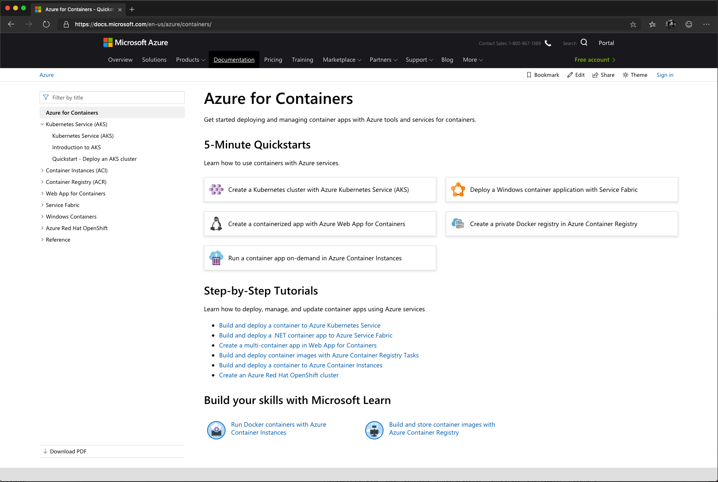
/Docs alert
Explore overviews, tutorials, samples, and more.
aka.ms/azure-containers-afun60

Slide 42
Invent with purpose.
Notes:
And that’s a statement around how we feel about Azure.
We want to invent with purpose in how we think about it what we deliver to you but also enable you to invent with purpose.
And we do that in some key ways.
TRANSITION: I talk about these ways as our promises to you on what Azure will always deliver and why we’ll help you.

